Slide 1
Pip the Pirate
Assessment

Slide 2
Go through the slides asking your child to say the sounds and read the words. If they can read all the sounds and words confidently, move onto Tommy the Scientist/Dream Like Lily.

Slide 3
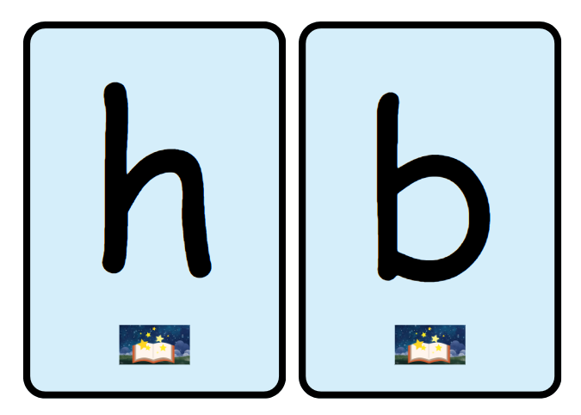

Slide 5
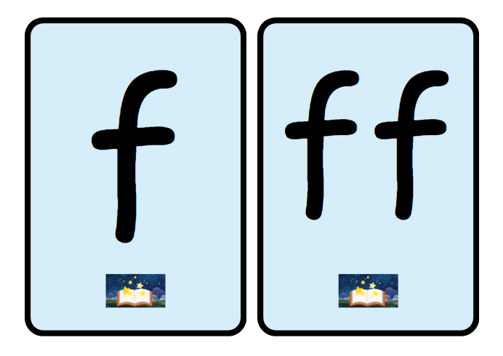

Slide 7
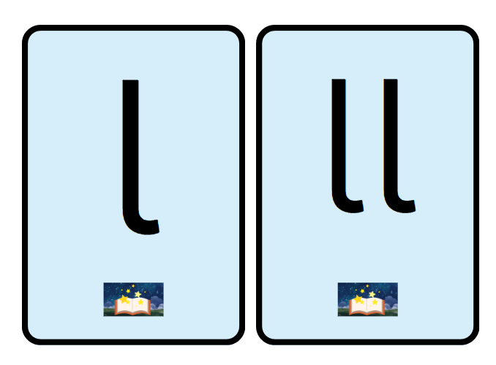

Slide 9
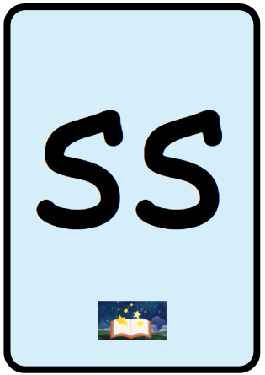

Slide 10
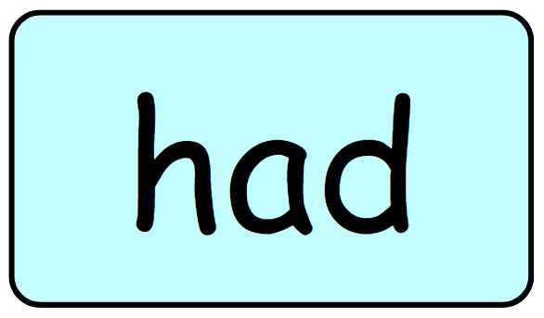

Slide 11


Slide 12
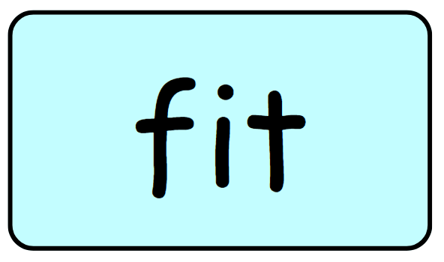

Slide 13
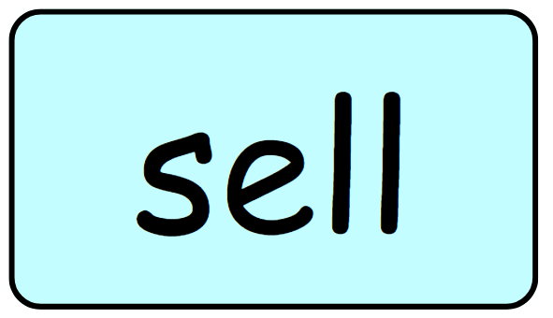

Slide 14


Slide 15
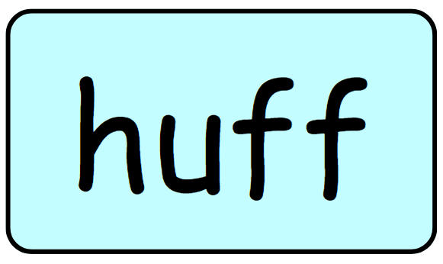

Slide 16


Slide 17
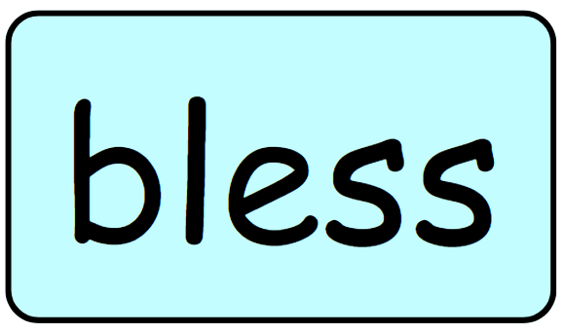

Slide 18


Slide 19
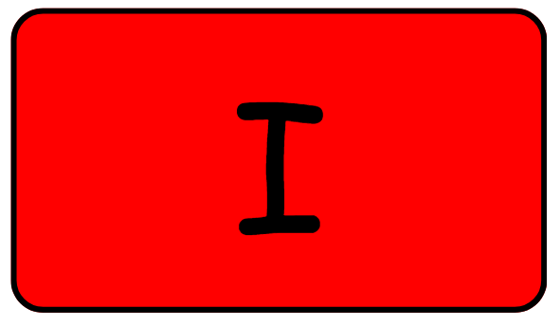

Slide 20


